Slide 1


Advertisement Click Through
Rate Prediction
ARUN PRASATH L
22PDS816
Data Science
St. Joseph's College
Internal Guide:
Dr. v. Arul kumar
Assistant Professor
Department of Data Science
St joseph’s college
External Guide:
Mr. syed asym muhamad
(developer) Airobosoft
Bengaluru

Slide 2

COMPANY PROFILE
AIROBOSOFT is a Bangalore based IT firm Leading a team of Data Scientist, Robotics &Electronics Engineers, experts in Machine Learning , collaborated together to work on fascinating futuristic technologies.
Industry: IT Services and IT Consulting.
Headquarters: Bengaluru, Karnataka
Specialtes:
Robotics
Artificial intelligence
Machine Learning
IOT
Software development.
Website: http://www.airobosoft

Slide 3
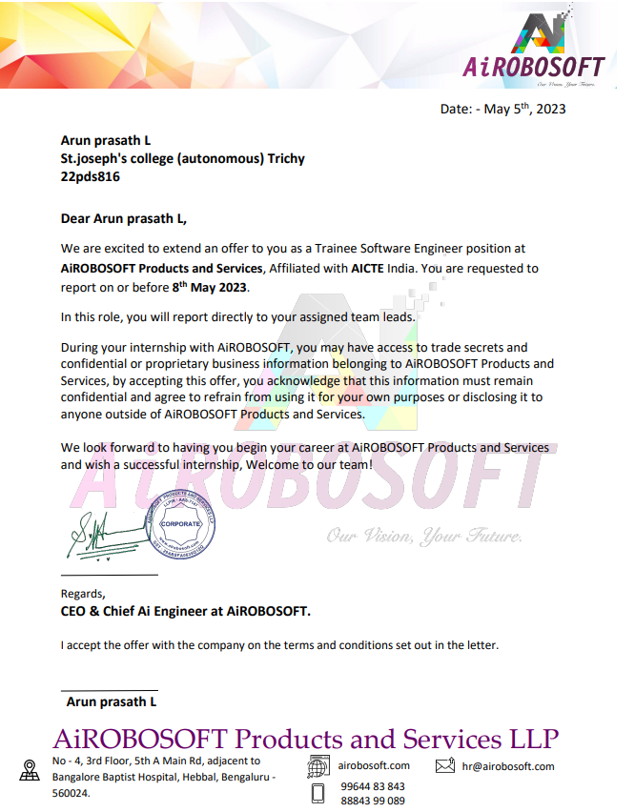
Acceptance Letter

Slide 4
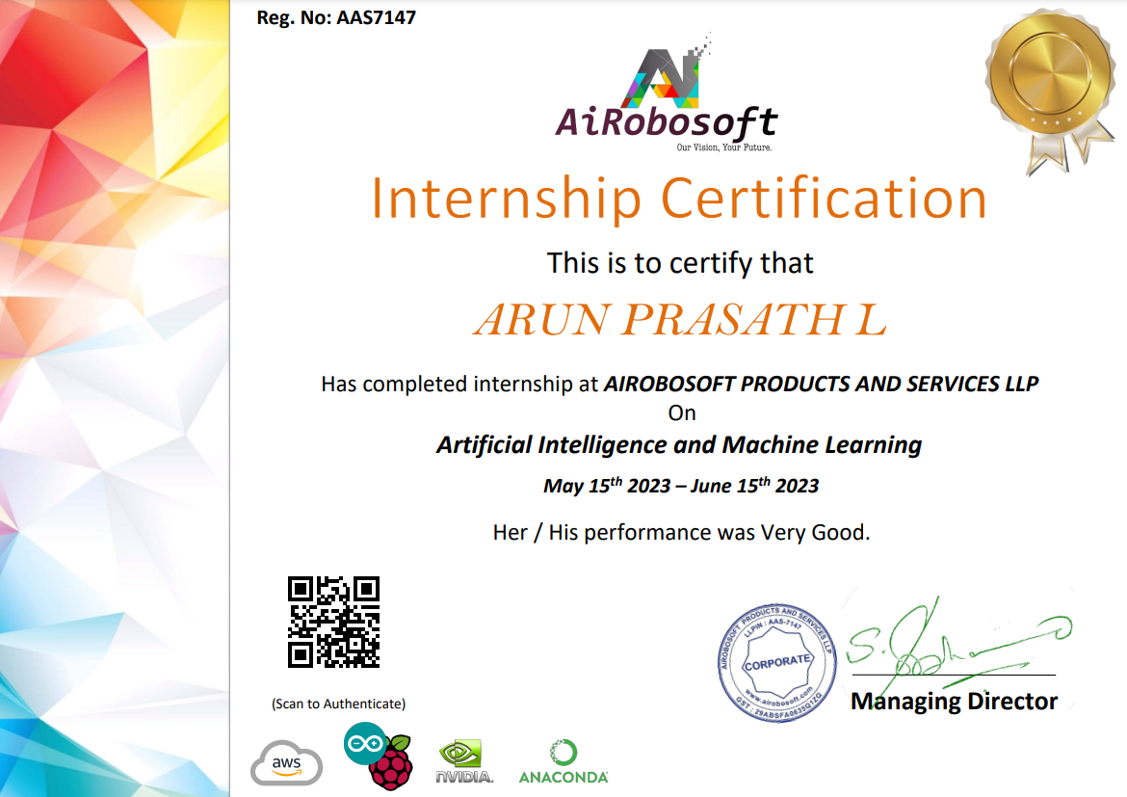
Completion Certificate

Slide 5
Agenda
Introduction
Company Profile
Problem statement
Background work
Technology Adopted
Details of the Tool Used
Solution for the Problem
Conclusion

Slide 6
INTRODUCTION
The click through rate (CTR) is a measure to understand the number of users that see an advertisement to the number of people who actually end up clicking on it. A high value of the click through rate is directly proportional to the usefulness of an advertisement. Advertisers invest substantial resources in reaching their target audience, but the ultimate success lies in the ability to engage users and drive click-throughs. Based on this measure, a business can be informed of how well the keywords that they have chosen is performing in their advertisement campaign.
There are two types of Customer:
Clicked on Ad
Non Clicked Ad
By accurately forecasting CTR, advertisers can make informed decisions and to target their potential customers with the right ad content.

Slide 7
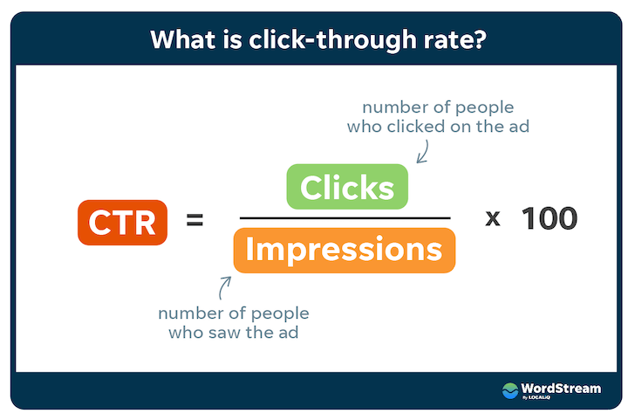
WHAT IS AD CLICK THROUGH RATE ?
Ads Click Through Rate is the ratio of how many users clicked on your ad to how many users viewed your ad. For example, 5 out of 100 users click on the ad while watching a website. So, in this case, the CTR of the website ad will be 5%. Analyzing the click-through rate help companies in finding the best ad for their target audience.

Slide 8
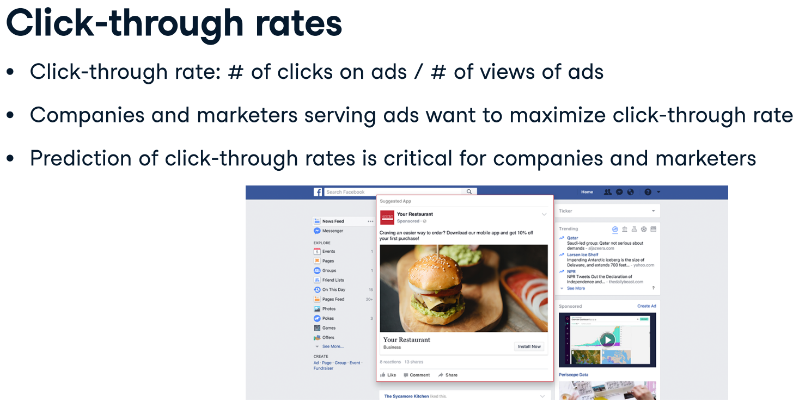
WHAT IS AD CLICK THROUGH RATE ?

Slide 9
PROBLEM STATEMENT
aims to calculate the click through rate of web advertisement.
internet usage time, age, gender and area of income how much users click the ad apart from the ad viewers and which age group of the people click the add.
It help advertisers can make informed decisions to optimize their ad campaigns and targeting strategies and give the relevant ad to the user.
The classification model will help to reduce the irrelevant ad content by accurately identifying users who are likely to click on the ad.

Slide 10
BACKGROUND WORK
I have collected the data from Kaggle, My dataset consists of ten attributes.
I referred many algorithms to get the clear idea about their usage in my work. To understand & learn the algorithms I followed
youtube channel: Mr.Shell
website: The Clever Programmer
I installed Jupyter notebook for my work. I have imported libraries in python for my work. After gathering that it was a little bit noise data so that I went to data pre-processing stage.
After cleaning the data, I selected the machine learning model according to my dataset. I trained & tested my data. Later I validated it. After that I evaluated my model.

Slide 11
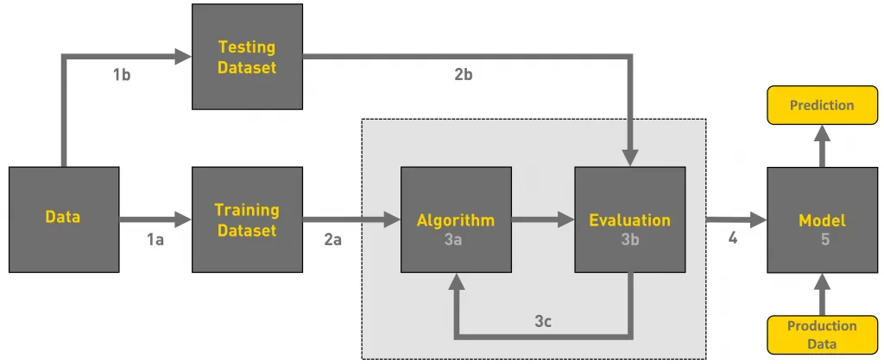
Work flow

Slide 12
TECHNOLOGY ADOPTED
Machine learning:
It focuses on the development of algorithms and models that enable computers to learn and make predictions or decisions.
It involves the use of statistical techniques and computational algorithms to analyze and interpret large amounts of data.
low cost
Highly scalable
Early identification
Accuracy improved

Slide 13
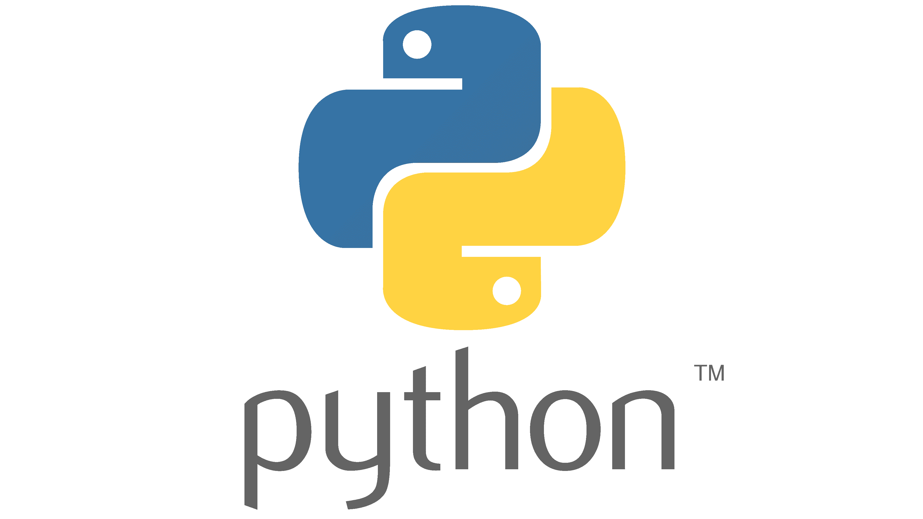

TOOLS USED
PYTHON LANGUAGE
Python is a high-level, interpreted programming language known for its simplicity and readability.
JUPYTER NOTEBOOK
Jupyter Notebook is an open-source web-based interactive computing environment.
It allows users to create documents called notebooks, which contain code, visualizations.
LIBRARIES
Pandas
NumPy
Plotly
Sklearn

Slide 14
ALGORITHM USED
Random forest classifier:
Random forest is a Supervised Machine Learning Algorithm that is used widely in Classification and Regression problems. It builds decision trees on different samples and takes their majority vote for classification. One of the most important features of the Random Forest Algorithm is that it can handle the data set containing continuous variables as in the case of regression and categorical variables as in the case of classification.
Logistic regression:
Logistic regression is a statistical modelling technique used for binary classification. It estimates the probability of an event occurring based on predictor variables.

Slide 15
Solution for the problem
Implementing two Machine Learning algorithms on the given dataset for Ad Click Through Rate
Prediction shows that Random Forest Classifier was the best model. The accuracy of Random Forest Classifier is high compared to Logistic Regression model.
ALGORITHM |  | ACCURACY
RANDOM FOREST | 0.9613
LOGISTIC REGRESSION | 0.69

Slide 16
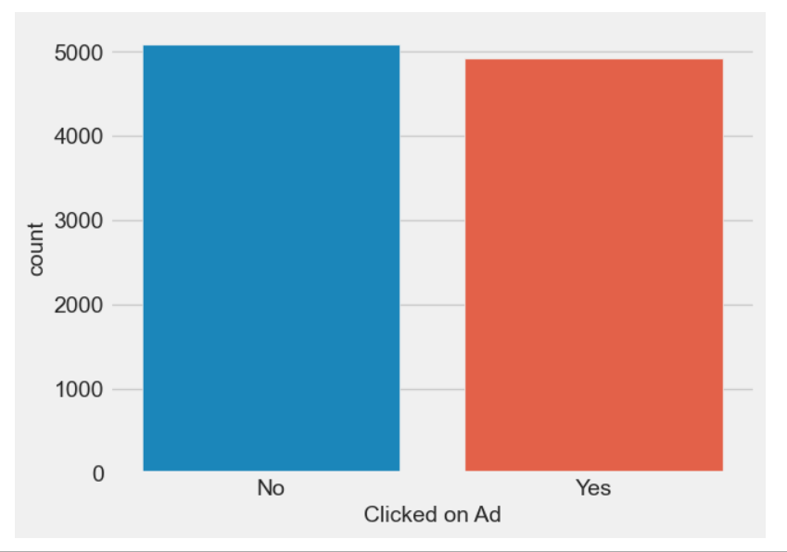
Conclusion
After evaluating the data, we discovered that 4917 users had clicked the ad whereas 5083 visitors had not.
• Female users clicked on the majority of the ads when we look at click data by Gender.
The individual who spent more time online clicked the ad.
• The Click Through Rate of this company is 49%, with this the company will find the marketing strategy and make better decision.
• Based on the CTR, the company will give the relevant ad to the user and also help to reduce the irrelevant ad content to the user.

Slide 17


Slide 18
